Slide 1


Locomotion Skills Bag
Gross Motor Skills
Have you thought about leaving a bag of toys in your car boot/by your door to develop your child’s locomotion skills at the park or beach?
Ideas for Parents and Carers
Things you could pack:
Chalk- Jumping, hopscotch, hopping, leaping, walking, running, galloping.
Cones- Jumping, hopping, leaping, running, walking, galloping.
Skipping Rope- Jumping, hopping, leaping, walking.

Slide 2
Manipulation Skills Bag
Gross Motor Skills
Have you thought about leaving a bag of toys in your car boot/by your door to develop your child’s manipulation skills at the park or beach?
Things you could pack:
Large ball- Catch, throw (overarm), roll, carry, collect, dribble (hands), dribble (feet), kick
Small ball- Throw (overarm/ underarm), roll, carry, collect, strike
Plastic racket/ plastic bat- Strike
Frisbee/ Howler Ball-Throw, carry, collect
Pétanque set- Throw (underarm), roll, carry, collect
Skittles set- Roll, carry, collect
Ideas for Parents and Carers

Slide 3
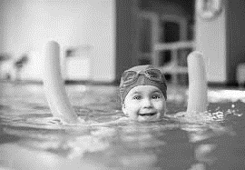
Swimming
Gross Motor Skills
Have you thought about accessing your local swimming pool? This helps your child develop their competence and confidence in water.
Ideas for Parents and Carers

Slide 4
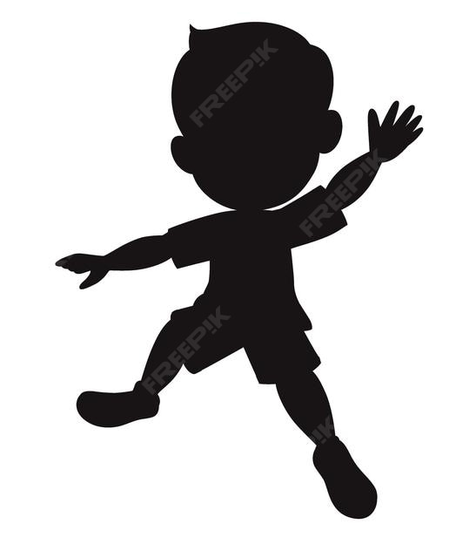
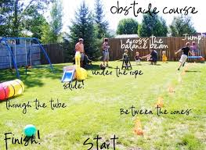
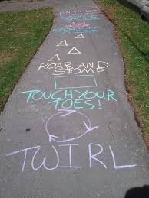
Top Tip
You could use chalk to create one too.
Obstacle Courses
Gross Motor Skills
Have you thought about creating an obstacle course to develop gross motor skills?
Ideas for Parents and Carers

Slide 5
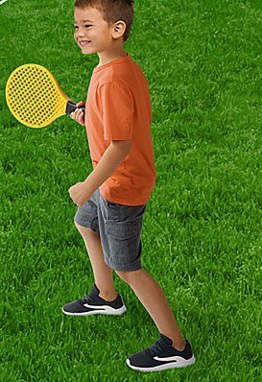
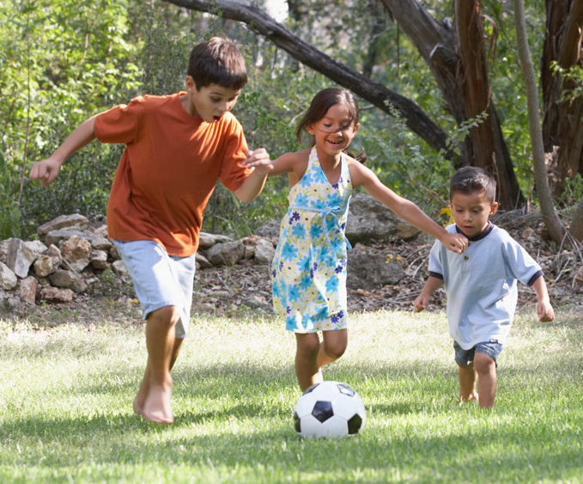
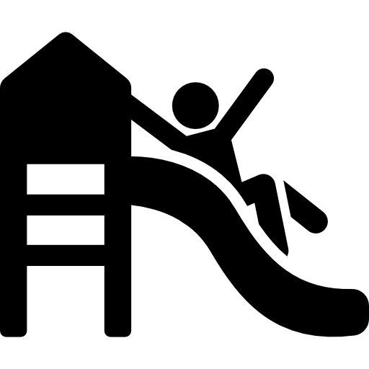
Ideas for Parents and Carers
To encourage manipulation skills, you could encourage play with:
-a big/small ball
-a howler ball
-a plastic bat/racket
-a frisbee
-a Pétanque set
Gross Motor Skills
Locomotion
What could I take to the park?

Slide 6
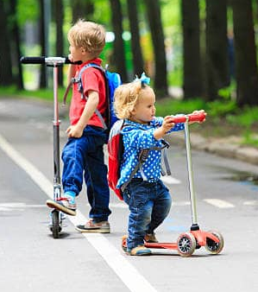
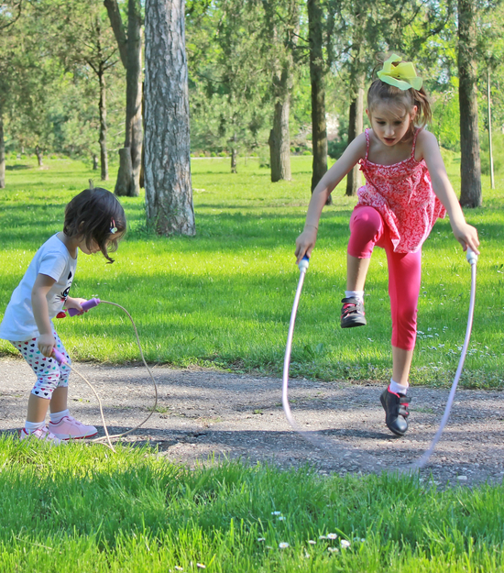
Ideas for Parents and Carers
To encourage locomotion skills, you could encourage play with:
-a bike
-a scooter
-the slide
-the climbing frame
-rolling on the grass
-a skipping rope
Gross Motor Skills
Locomotion
What could I use at the park?

Slide 7
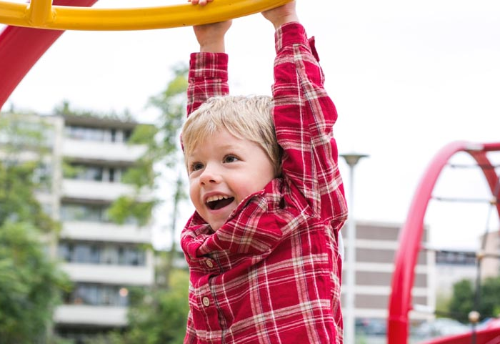
Ideas for Parents and Carers
To encourage stabilisation skills, you could encourage play with:
-a swing
-the slide
-the climbing frame for hanging
-the roundabout
-the seesaw
Gross Motor Skills
Locomotion
What could I use at the park?

